Slide 1
Evaluating online sources and identifying misinformation
Developed by Yael Rozenblum and Dr. Keren Dalyot from the Faculty of Education in Science and Technology, Israel

Slide 2
2. Eating tuna helps keep your heart healthy
3. Sugar from fruits is healthy because it is from fruit
True or False
1. Chocolate is good for concentration
4. Tuna contains mercury and should be avoided
5. Frying destroys olive oil and it can cause cancer
6. Chocolate causes acne

Slide 3
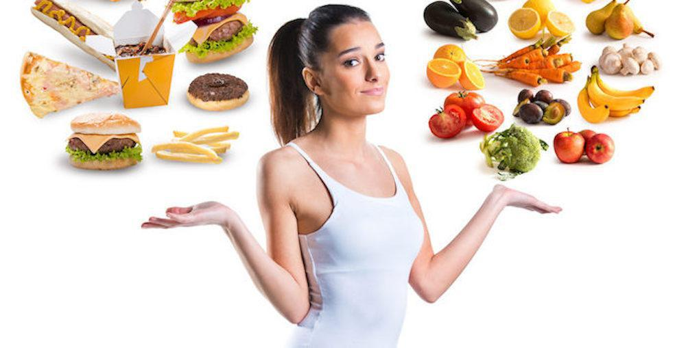
What nutrition-related decision/s have you made in the past day/week?
https://www.danversdocs.com/blog/what-to-eat-and-not-eat-to-prevent-high-blood-pressure

Slide 4
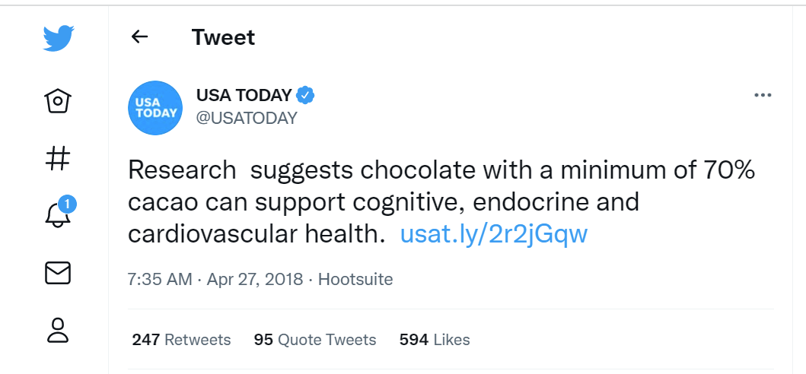
What if you read this tweet? Would you eat more dark chocolate?

Slide 5
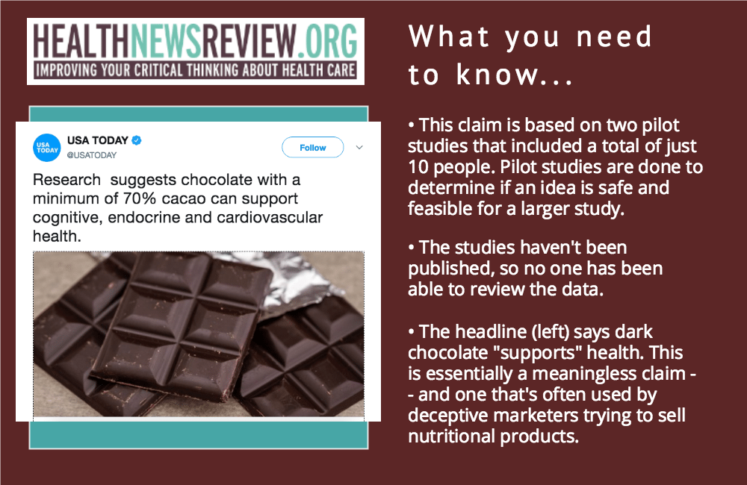
Source: https://www.healthnewsreview.org/2018/05/dark-chocolate-and-health-fudging-the-evidence-with-usa-today/

Slide 6
So, what can we do?
Some Suggested Indicators for Evaluation
Authority of
The author (credentials as well as the experts they rely on).
The publisher (platform).
Objectivity - Can you identify the interests of the publisher/author?
How current is the information?

Slide 7
Criterion |  | The extent to which the criterion appears in the information section
 |  | Does not appear (-) | Appears slightly (+) | to a large extent (++)
Authority | author | The writer of the section does not deal with the subject in question and it is not clear from the writing that they interview experts in the field for writing. | The writer of the section is unknown or unknown to what extent they are familiar with the beginning or is based on the words of interviewees who are not competent in the field. | The writer of the section is well known in the field, or a representative of a well Known body in the field, or relies on expert opinions in the field and quotes their words.
 | publisher | The source where the information is published is unknown and unknown, or does not belong to the specific domain. | The source where the information is published is unknown or unknown to what extent its relationship with the domain. | The source where the information is published is a well-known body in the field, a well-known newspaper or a well-known book publisher.
Objectivity |  | The information is not objective. It is likely that the publisher is interested in hiding or discovering data. The writer expresses positions as if they were working. | The objectivity of the information publisher is unknown. There is sometimes a mix of facts and opinions. | The information publisher has no interest in displaying false data. It is recognized or belongs to an objective research institution or public institution with no commercial interest in the subject matter. There is no mixing of facts and opinions.
Current/updated |  | The information is out of date, or the date of writing is unknown. Given the topic the section is about, there have probably been innovations in the field since publication. | The information is quite outdated. Given the topic the section is about, there may have been innovations since publication. | The information is very updated. In the case of news information, there is a correlation between the writing date and the reported event dates, there are updated links

Slide 8
Using criteria to evaluate information on food
In small groups
Each group receives:
a matrix for evaluation
links to 2 information sources
Complete the matrix for each source
Choose a representative to present one source and you matrix to the class.

Slide 9

Summary
When encountering science and food related information on social media or mainstream media. Think, reflect and evaluate:
Nature of science and scientific work - do we have information about any scientific evidence? Can we evaluate it? Do we know someone we can ask?
What is the authority of the writer or publisher to make the claims they are making?
What are the underlying interests for publishing this information?
How recent is it?

Slide 10
Thank you!

